Slide 1

Objectness&Face Detection
赵海伟 戴嘉伦 王如晨
CVBIOUC,Ocean University of China
指导教师：郑海永

Slide 2
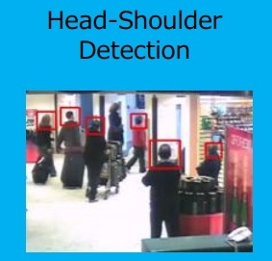
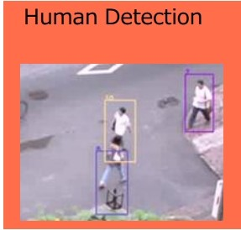
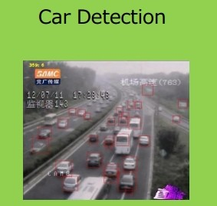
Object detection
The limitations and failures of Object detection ：
Only solving the problem of a certain kind of target detection
Detection accuracy is low
The size of training dat set is difficult to determine
Detection time is long
It is necessary to develop more powerful methods
Notes:
由于测试时需要遍历窗口因此非常消耗计算资源，这样对于一个实时的行人监测系统来说，我们只好选择弱特征（为快速计算，如HOG），以及弱的分类器（也是为了快速计算，如SVM）。为了改变这种情况，我们直观的想法是如果能够利用人是“物体”这种先验知识，先提取出含有物体的窗口，也就是先筛选出proposals，我们就能用一些稍微复杂的特征和分类器在这些候选窗口上过滤。

Slide 3
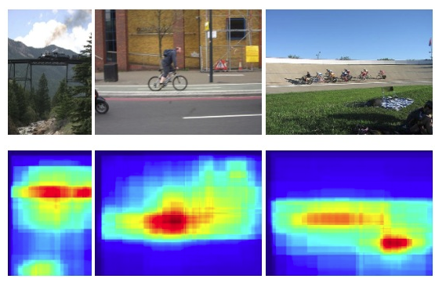

Objectness
Objectness map:
Showing the distribution of object location.
What are the benefits?
Improving computational efficiency by reducing the search space
Allowing the usage of strong classifiers during testing to improve accuracy
Measuring the objectness of image windows. PAMI 2012, Alexe, et. al.
Notes:
Objectness is usually represented as a value which reflects how likely an image window covers an object of any category.

Slide 4
Computer Vision
Computer Vision
Input
Pre-proccessing
Detection
Segmentation
Objectness
Objectness
Matching
Saliency
Recognition
3D Modeling
Output

Slide 5
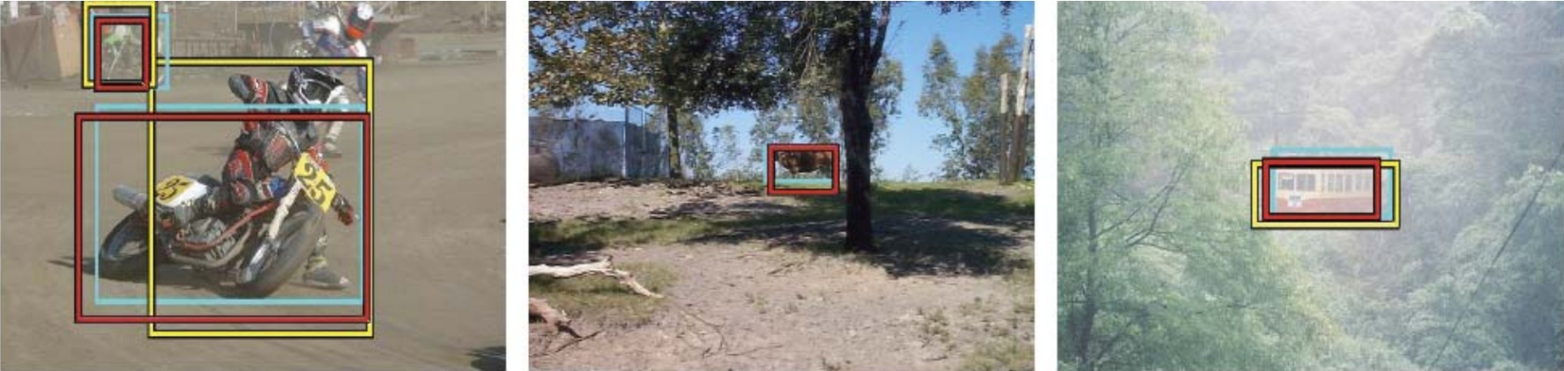
Objectness
Objectness proposal generation methods
A small number (e.g. 1K) of category-independent proposals
Expected to cover all objects in an image
What is an object ?, CVPR 2010 , Alexe et. al.
Measuring the objectness of image windows. PAMI 2012, Alexe, et. al.
Selective Search for Object Recognition, IJCV 2013, Uijlings et. al.
Category-Independent Object Proposals With Diverse Ranking, PAMI 2014, Endres et. al.
Proposal Generation for Object Detection using Cascaded Ranking SVMs. CVPR 2011, Zhang et al.
Learning a Category Independent Object Detection Cascade. ICCV 2011, Rahtu et. al.
Generating object segmentation proposals using global and local search, CVPR 2014, Rantalankila et al.

Slide 6
Objectness&Face Detection
Introduction
Related works
Fixation prediction/Salient object detection/Image
segmentation/Image matching
Data Set
What is a good objectness measure?
Objectness
The first kind of objectness method
What is an object?
BING:Binarized Normed Gradients for Objectness Estimation at 300fps
The second kind of objectness method
Segmentation as Selective Search for Object Recognition
Category-Independent Object Proposals with Diverse Rankding
The third kind of objectness method
Data-driven Objectness

Slide 7
Related works
Computer Vision
Input
Pre-proccessing
Detection
Segmentation
Objectness
Matching
Saliency
Recognition
Detection
Matching
3D Modeling
Recognition
Segmentation
Output

Slide 8
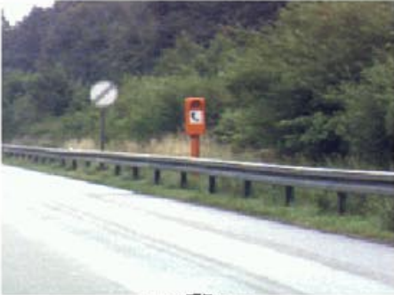
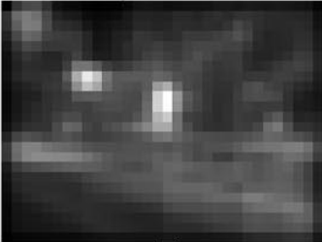
Related works
Fixation prediction
Predicting saliency points of human eye movement
A model of saliency-based visual attention for rapid scene analysis. PAMI 1998, Itti et al.
Saliency detection: A spectral residual approach. CVPR 2007, Hou et. al.
Graph-based visual saliency. NIPS, Harel et. al.
Quantitative analysis of human-model agreement in visual saliency modeling: A comparative study, IEEE TIP 2012, Borji et. al.
A benchmark of computational models of saliency to predict human fixations, TR 2012.

Slide 9
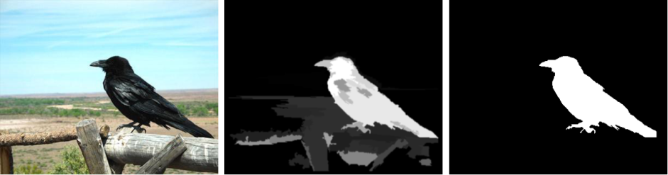
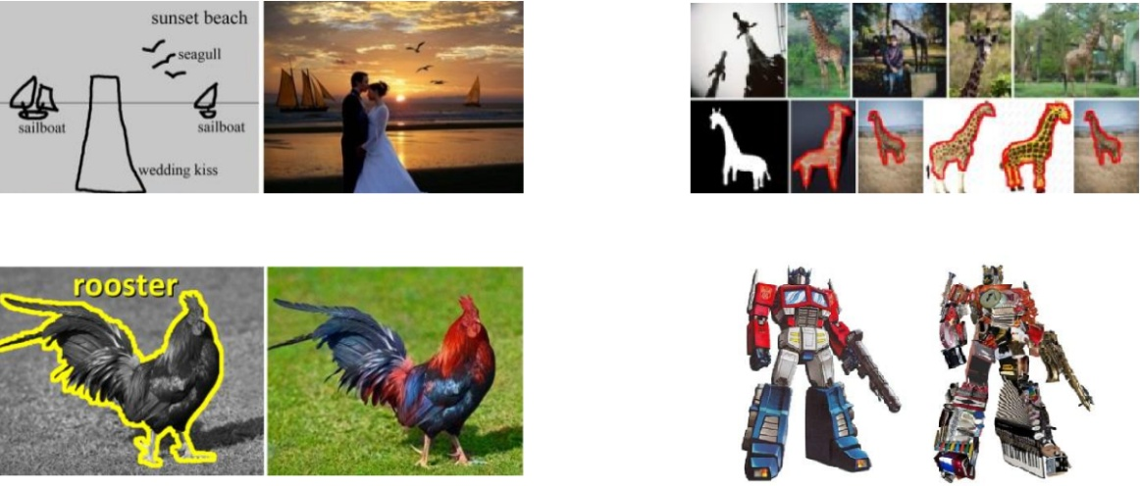
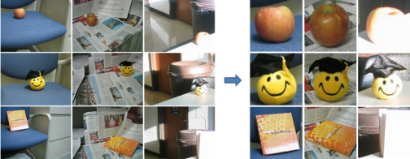
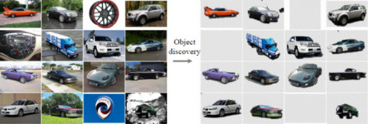
Related works
Salient object detection
Detect the most attention-grabbing object in the scene
Applications
Learning to detect a salient object. CVPR 2007, Liu et. al.
Frequency-tuned salient region detection, CVPR 2009, Achanta et. al.
Global contrast based salient region detection, CVPR 2011, Cheng et. al.
Salient object detection: a benchmark, Ali et. al.
[ACM TOG 09, Chen et. al.] [Vis. Comp. 13, Cheng et. al.] [CVPR 12, Zhu et. al.]
[ACM TOG 11, Chia et. al.] [ACM TOG 11, Zhang et. al.] [CVPR 13, Rubinstein et. al.]

Slide 10
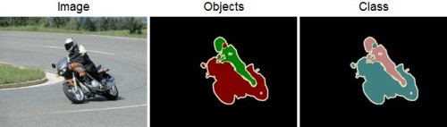
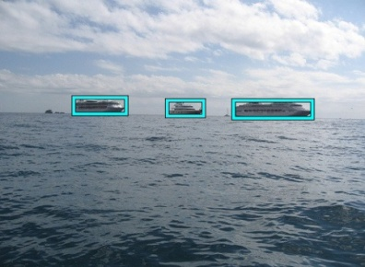
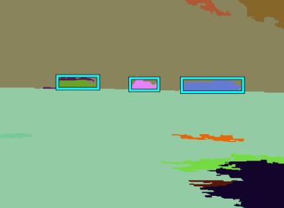
Related works
Image segmentation(Demo)
Each solid color corresponds to a distinct annotated object.
All other pixels are considered background.
Superpixel segmentation
Learning a classification model for segmentation.IEEE 2003, Ren et. al.
Efficient graph-based image segmentation .2004 Felzenswal et .al.
Normalized cuts and image segmentation .IEEE 1997,SHI J,et .al.
Entropy rate superpixel segmentation.CVPR 2011,Liu M Y,et .al.

Slide 11
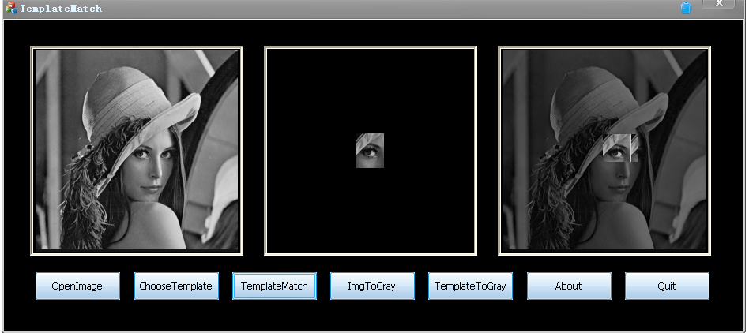
Related works
Image matching(Demo)
Based on image content, features, structure, relation,et al
Analysis the similarity and consistency
Seeking similar image target
Comparing images using the Hausdorff distance under translation.CVPR 1992, Huttenlocher et. al.
Comparing Images Using the Hausdorff Distance.PAMI 1993, Daniel, et.al.
A modified Hausdorff distance for object matching.ICPR 1994, Jain, et .al.
Object matching algorithm using robust Hausdorff distance measure.1999 Sim,et.al.

Slide 12
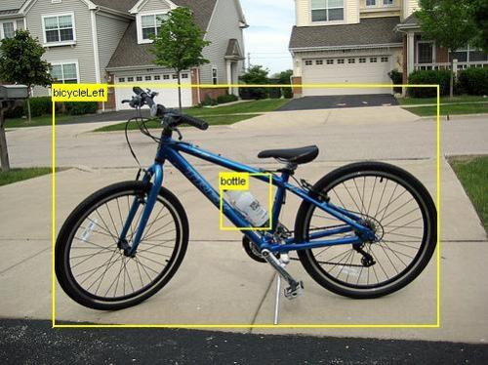
Data Set
Data Set（PASCAL VOC 2007）

Slide 13
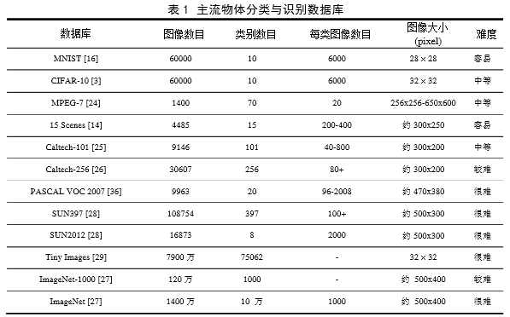
Data Set
Data Set

Slide 14
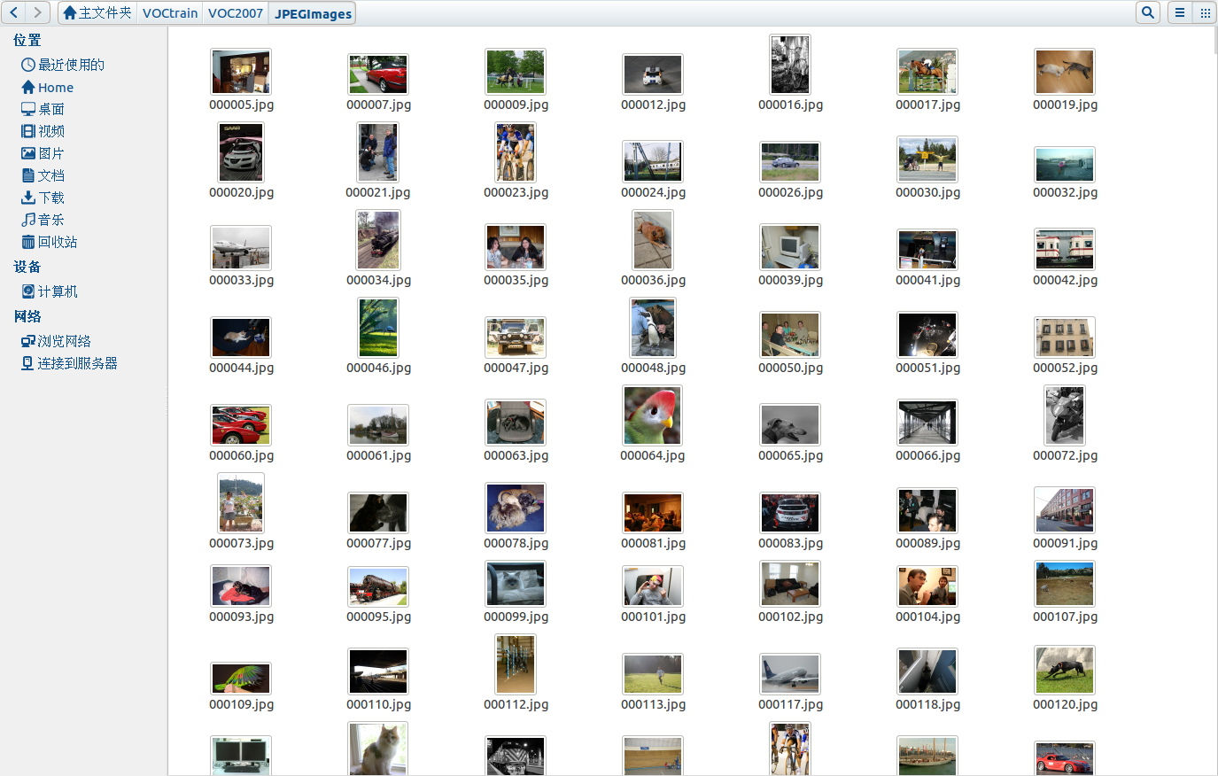
Data Set

Slide 15
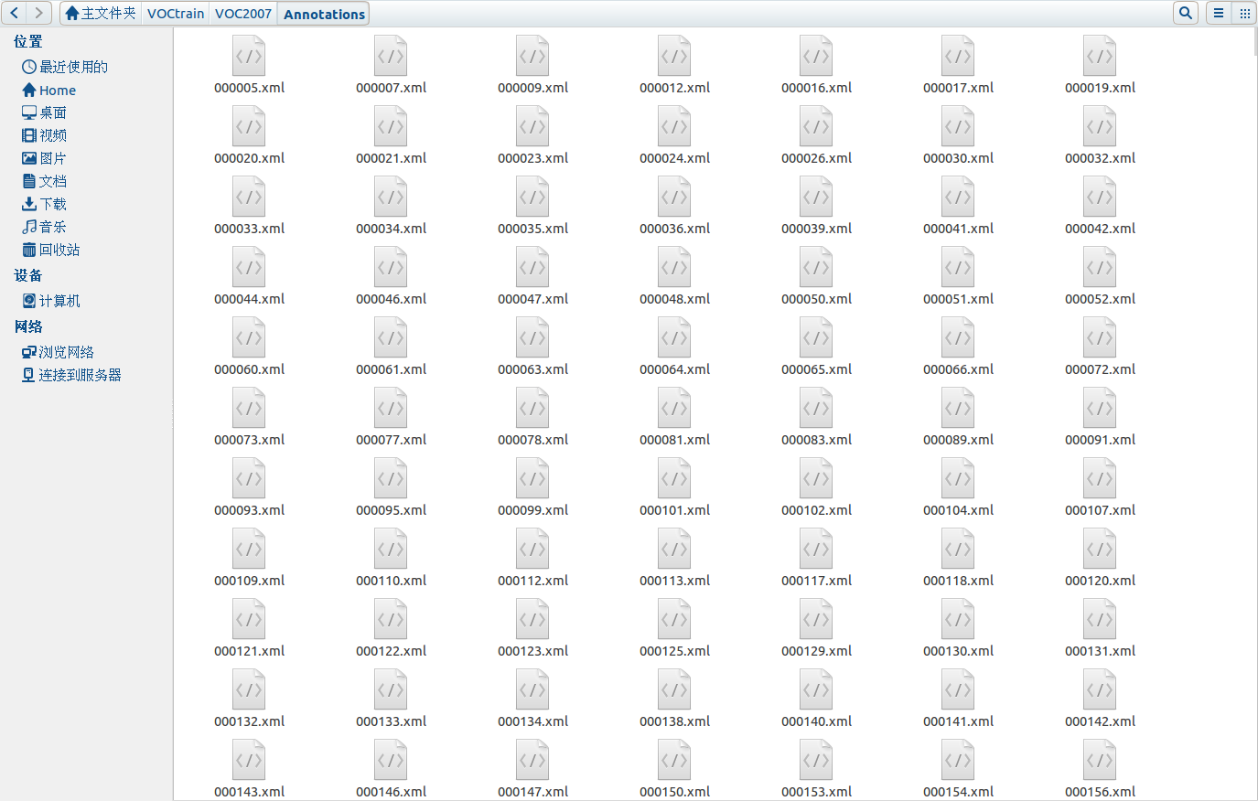
Data Set

Slide 16
Good objectness measure
What is a good objectness measure?
Achieve high object detection rate (DR)
Any undetected object at this stage cannot be recovered later
Produce a small number of proposals
Reducing computational time of subsequent detectors
Obtain high computational efficiency
The method can be easily involved in various applications
Especially for realtime and large-scale applications
Have good generalization ability to unseen object categories
The proposals can be reused by many category specific detectors
Greatly reduce the computation for each of them
BING: Binarized Normed Gradients for Objectness Estimation at 300fps, CVPR 2014, Ming-Ming Cheng et. al.

Slide 17
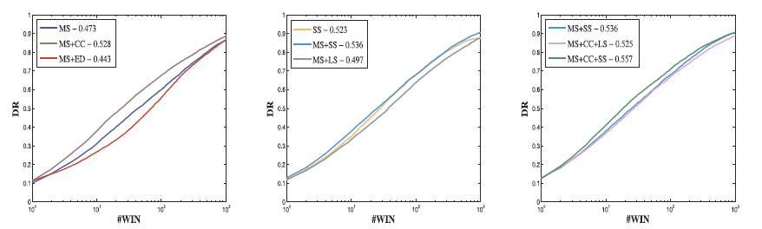
Good objectness measure
Achieve high object detection rate (DR)
Any undetected object at this stage cannot be recovered later
What is an object ?, CVPR 2010 , Alexe et. al.
Measuring the objectness of image windows. PAMI 2012, Alexe, et. al.
BING: Binarized Normed Gradients for Objectness Estimation at 300fps, CVPR 2014, Ming-Ming Cheng et. al.

Slide 18
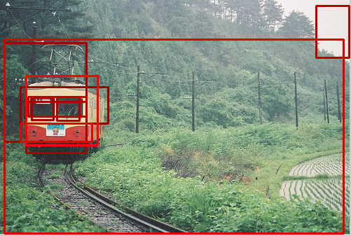
Good objectness measure
Produce a small number of proposals
Reducing computational time of subsequent detectors
What is an object ?, CVPR 2010 , Alexe et. al.
Measuring the objectness of image windows. PAMI 2012, Alexe, et. al.
BING: Binarized Normed Gradients for Objectness Estimation at 300fps, CVPR 2014, Ming-Ming Cheng et. al.

Slide 19
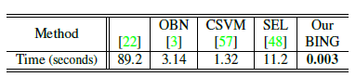
Good objectness measure
Obtain high computational efficiency
The method can be easily involved in various applications
Especially for realtime and large-scale applications
BING: Binarized Normed Gradients for Objectness Estimation at 300fps, CVPR 2014, Ming-Ming Cheng et. al.

Slide 20
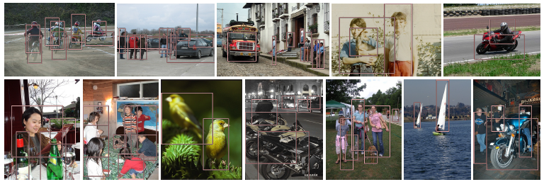
Good objectness measure
Have good generalization ability to unseen object categories
The proposals can be reused by many category specific detectors
Greatly reduce the computation for each of them
BING: Binarized Normed Gradients for Objectness Estimation at 300fps, CVPR 2014, Ming-Ming Cheng et. al.

Slide 21
Objectness
What is an object?
BING:Binarized Normed Gradients for Objectness estimation at 300fps.
Segmentation as Selective Search for Object Recognition
Category-Independent Object Proposals
Data-driven Objectness

Slide 22
Objectness
What is an object?
BING:Binarized Normed Gradients for Objectness estimation at 300fps.
Segmentation as Selective Search for Object Recognition
Category-Independent Object Proposals
Data-driven Objectness

Slide 23
The first kind of objectness method
The first kind of objectness method
A value to reflect how likely an image window covers an object of any category [PAMI 12 Alexe et. al.].
What is an object ?, CVPR 2010 , Alexe et. al.
Measuring the objectness of image windows. PAMI 2012, Alexe, et. al.
BING: Binarized Normed Gradients for Objectness Estimation at 300fps, CVPR 2014, Ming-Ming Cheng et. al.

Slide 24
The first kind of objectness method
BING: Binarized Normed Gradients for Objectness Estimation at 300fps, CVPR 2014, Ming-Ming Cheng et. al.
Notes:
1.滑动窗口策略。2.广义霍夫变换:广义霍夫投票方法则是通过在参数空间进行累加，根据局部极值获得物体位置的方法，可以用于任意形状的检测和一般物体检测任务。

Slide 25
The first kind of objectness method
> >

Slide 26
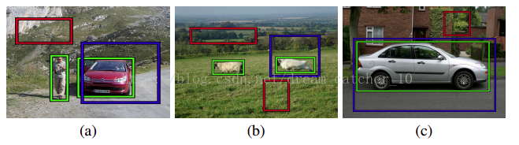
What is an object?
We argue that any object has at least one of three distinctive characteristics:
(a) a well-defined closed boundary in space.
(b) a different appearance from their surroundings.
(c) sometimes it is unique within the image and stands out as salient.
Many objects have several of these characteristics at the same time.
What is an object ?, CVPR 2010 , Alexe et. al.
Measuring the objectness of image windows. PAMI 2012, Alexe, et. al.
Notes:
分别对应：边缘、颜色、显著三个特征。边缘-ED、SS,颜色-CC，显著性-MS。

Slide 27
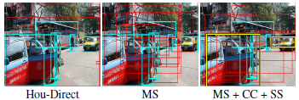
Methodology of What is an object
What is an object ? (Demo)
This measure combines in a Bayesian framework several image cues based on the above characteristics.
The combined objectness measure performs better than any cue alone.
Objectness can be used as a location prior for modern class-specific object detectors.
What is an object ?, CVPR 2010 , Alexe et. al.
Measuring the objectness of image windows. PAMI 2012, Alexe, et. al.
Notes:
演示what is an object?这篇论文效果

Slide 28
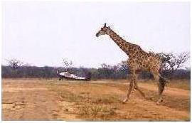
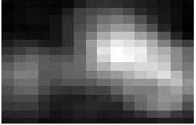
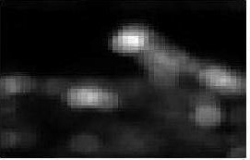
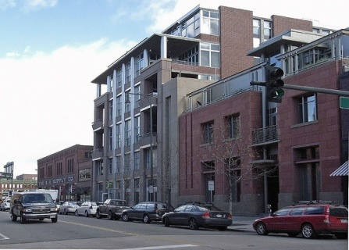
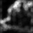
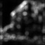
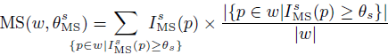
Methodology of What is an object
Multiscale Saliency (MS)
Success: Having multi-scale saliency maps is important for finding more objects in challenging datasets.
Failure: The numerous cars in the original image are not salient at any scale.
What is an object ?, CVPR 2010 , Alexe et. al.
Measuring the objectness of image windows. PAMI 2012, Alexe, et. al.
Notes:
28.目的在于使整个高显著块附近的相关窗口得分最高。
窗口W的MS得分：（显著值>参数）*显著值/窗口内像素总数
MS对图像目标进行了初步定位。如果单独作用，对于某些显著性较高的图像效果较好，但是对于某些背景比较复杂的图像会效果差些。

Slide 29
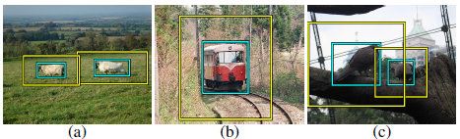
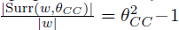
Methodology of What is an object
Color Contrast (CC) (Demo)
Success: the windows containing the objects (cyan) have high color contrast with their surrounding ring (yellow) in images (a) and (b).
Failure: the color contrast for windows in cyan in image (c) is much lower.
What is an object ?, CVPR 2010 , Alexe et. al.
Measuring the objectness of image windows. PAMI 2012, Alexe, et. al.
Notes:
29.LAB直方图描述的是不同色彩在整幅图像中所占的比例，而并不关心每种色彩所处的空间位置。由于图像上的前景物体和背景颜色分布差异很大，从而在直方图上会出现双峰特征，但背景和前景颜色较为接近的图像不具有这个特征。
一个窗口与其周边环境的颜色对比度CC，由窗口与其周围环境LAB直方图的卡方距离度量。
颜色对比仅对图像目标与背景颜色差异大的图像起作用，如果图像目标自身颜色多变，或者与周围环境相似，则此时颜色对比线索失效。

Slide 30
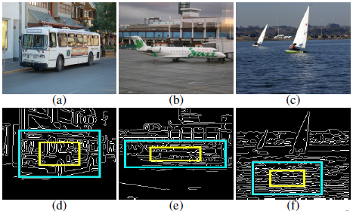
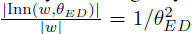
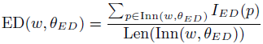
Methodology of What is an object
Edge Density (ED)(Demo)
Success: The cyan windows covering the bus and the aeroplane score high as the density of edges is concentrated in these regions.
Failure: The cyan window along with many other windows covering the water score high determining a high rate of false positives.In particular the windows covering the boats have a low score.
What is an object ?, CVPR 2010 , Alexe et. al.
Measuring the objectness of image windows. PAMI 2012, Alexe, et. al.
Notes:
30.窗口按参数缩小为Inn，ED得分：内环圈上的边缘值之和/内环周长

Slide 31
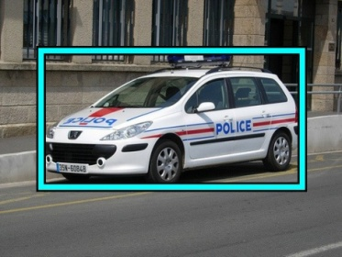

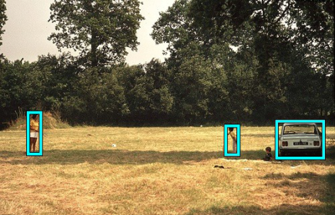
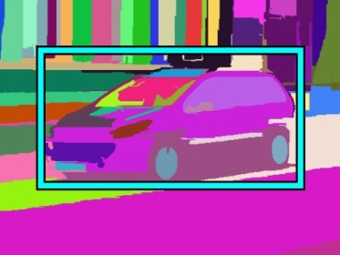


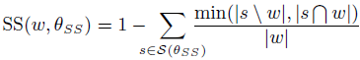
Methodology of What is an object
Superpixels Straddling (SS)
Success: The cyan windows in (a) and (b) have high SS score computed from segmentations (d) and (e).
Failure: Segmentation produces superpixels (f) not preserving the boundaries of the small objects in (c), resulting in low SS.
What is an object ?, CVPR 2010 , Alexe et. al.
Measuring the objectness of image windows. PAMI 2012, Alexe, et. al.
Notes:
31.一个超像素中的所有的像素点都属于同一个目标，即使一个目标物体被过分割为几个超像素，也不会有一个跨越它的边界。
对于每一个超像素S，计算此超像素与待测窗口交集｜S∩W｜，以及超像素位于待测窗口外部的区域｜S／W｜。两者的最小值即为此超像素跨越窗口W的程度，然后计算所有超像素跨越程度的总和。
超像素完全位于窗口内部或外部对于式中加和的贡献值为0，所以SS将得分较高。对于一个跨越的超像素，当它大部分位于窗口内部或者外部，对于式中加和的贡献也是比较低的。所以,SS线索对于紧紧包围目标的窗口得分最高。

Slide 32
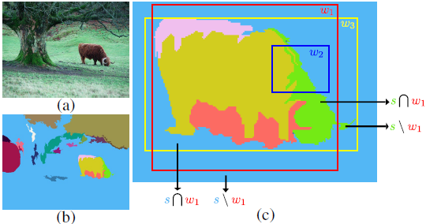
Methodology of What is an object
Superpixels Straddling (SS)
In (c), most of the surface of w1 is covered by superpixels contained almost entirely inside it. Instead, all superpixels passing by w2 continue largely outside it. Therefore, w1 has a higher SS score than w2. The window w3 has an even higher score as it fits the object tightly.
What is an object ?, CVPR 2010 , Alexe et. al.
Measuring the objectness of image windows. PAMI 2012, Alexe, et. al.

Slide 33
Methodology of What is an object
Algorithm framework
获取训练集
参数学习
获取测试集
MS获取窗口
MS得分
CC得分
ED得分
SS得分
贝叶斯融合
选出得分较高窗口
Notes:
先用MS获得均匀覆盖在物体上的10w个窗口，之后计算各个窗口在线索下的得分，之后进行贝叶斯融合，选出得分较高的窗口。

Slide 34
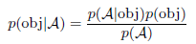
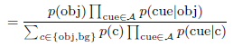
Methodology of What is an object
Bayesian cue integration
When a test image is given, we can sample any desired number T of windows from MS and then compute the other cues for them (as done above for obtaining training windows).
Learning cue parameters
Learing priors
What is an object ?, CVPR 2010 , Alexe et. al.
Measuring the objectness of image windows. PAMI 2012, Alexe, et. al.
Notes:
以上4个图像线索是完全独立且不相互影响，那么同时使用其中若干个线索有可能提高目标检测效果。如果简单线性组合各个线索，由于结合线索过分单纯化，适用性较差。
学习参数
贝叶斯分类器的分类原理是通过某对象的先验概率，利用贝叶斯公式计算出其后验概率，即该对象属于某一类的概率，选择具有最大后验概率的类作为该对象所属的类。目前研究较多的贝叶斯分类器主要有四种，分别是：Naive Bayes、TAN、BAN和GBN。
A为线索集

Slide 35
Training of What is an object
Algorithm framework
获取训练集
参数学习
获取测试集
MS获取窗口
MS得分
CC得分
ED得分
SS得分
贝叶斯融合
选出得分较高窗口

Slide 36
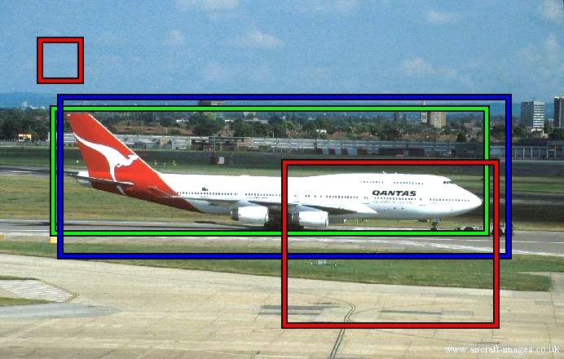
Training of What is an object
Training examples
Given an image we generate 100000 uniformly distributed windows and label them as positive or negative according to the PASCAL criterion.
The annotated object window (green)
A positive (blue) examples
Two negative (red) examples
What is an object ?, CVPR 2010 , Alexe et. al.
Measuring the objectness of image windows. PAMI 2012, Alexe, et. al.

Slide 37
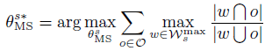
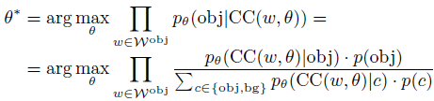
Training of What is an object
Learning cue parameters
Learing
Learing
What is an object ?, CVPR 2010 , Alexe et. al.
Measuring the objectness of image windows. PAMI 2012, Alexe, et. al.
Notes:
最优的阈值应使窗口与VOC2007库中训练图像的GroundTrueth中提供的目标窗口交并比达到最大值。
使用确定的阈值可以使得显著性高的块尽量突出，便于目标较准确地初步定位。
对于每一张训练集中的图像，使用滑动窗口算法产生均匀分布在整张图像的十万个窗口。最优的参数值应使窗口成为正样例的可能性最大。
各个参数的学习的目的都是一致的，都在于提高图像窗口覆盖目标物体的可能性，以便在将来的实验中更准确地目标检测定位。

Slide 38
Training of What is an object
Learing priors
Learing
Learing
Using density estimation
What is an object ?, CVPR 2010 , Alexe et. al.
Measuring the objectness of image windows. PAMI 2012, Alexe, et. al.
Notes:
滑动窗口机制产生的窗口与GroundTrueth中的目标窗口比较，得出正负样本的概率。
正样本：一个窗口与GroundTrueth中目标窗口的交并比大于0.5，则定义为正样本。
先验概率采用直方图密度估计。按照一定的步长将窗口得分数据值覆盖的数据区间分成几个等子区间；统计落在各个子区间中由各个线索决定的正样例
的个数，得到3组先验概率。

Slide 39
What is an object?
Algorithm framework
获取训练集
参数学习
获取测试集
MS获取窗口
MS得分
CC得分
ED得分
SS得分
贝叶斯融合
选出得分较高窗口

Slide 40
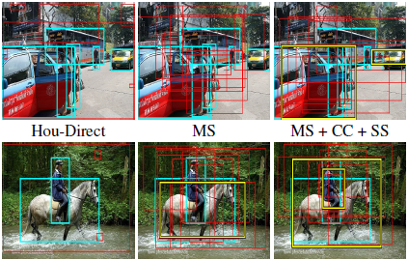
Experimental results of What is an object?
Results on Pascal VOC 07
We mark in yellow windows correctly covering ground-truth object (cyan); if there is more than one correct window,the best one is shown; all other windows are in red.
What is an object ?, CVPR 2010 , Alexe et. al.
Measuring the objectness of image windows. PAMI 2012, Alexe, et. al.
Notes:
黄色框图为class-specific detections结果。红色框图为论文结果。青绿色框图为Groundtruth。

Slide 41
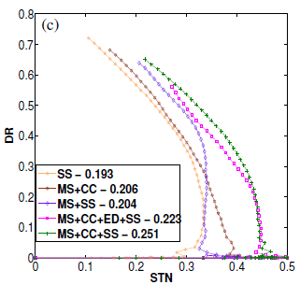
Experimental results of What is an object?
DR/STN plots
What is an object ?, CVPR 2010 , Alexe et. al.
Measuring the objectness of image windows. PAMI 2012, Alexe, et. al.
Notes:
击中率：得分前十名的窗口分别与测试库提供的GroundTrueth中目标所在的矩形框求交集与并集，计算交集与并集的比值。至少有一个窗口计算得到的交并比大于0.5，则认为击中；所有窗口计算得到的的交并比小于等于0.5，则认为未击中。
检测率：检测目标窗口与测试库提供的GroundTrueth中目标所在矩形框进行交集与并集的计算。如果交并比大于0.5，则认为检测成功；如果交并比小于等于0.5，则认为检测失败。

Slide 42
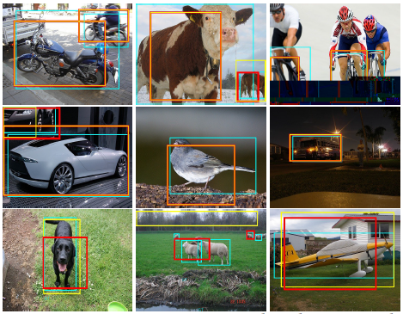
Experimental results of What is an object?
Compare with class-specific detections
What is an object ?, CVPR 2010 , Alexe et. al.
Measuring the objectness of image windows. PAMI 2012, Alexe, et. al.

Slide 43


The first kind of objectness method
Ming-Ming Cheng
BING: Binarized Normed Gradients for Objectness Estimation at 300fps
In CVPR, 2014

Slide 44

Methodology of BING : Observation
Objects are stand-alone things with well defined closed boundaries and centers.
Little variations could present in such abstracted view.
Finding pictures of objects in large collections of images. Springer Berlin Heidelberg, 1996, Forsyth et. al.
Using stuff to find things. ECCV 2008, Heitz et. al.
Measuring the objectness of image window, IEEE TPAMI 2012, Alexe et. al.
Notes:
物体的梯度分布呈现出较为杂乱的模式，而背景的较为单一和清楚。背景区域往往呈现出均匀的特性。NG：梯度的欧式norm。
36种不同的规模

Slide 45

Methodology of BING : Feature & Learning
Normed gradients (NG) + Cascaded Linear SVMs
Normed gradient means Euclidean norm of the gradient
BING: Binarized Normed Gradients for Objectness Estimation at 300fps, CVPR 2014, Ming-Ming Cheng et. al.

Slide 46

Methodology of BING : Feature & Learning
Normed gradients (NG) + Cascaded Linear SVMs
Detect at different quantized scale and aspect ratios
An 8x8 region in the normed gradient maps forms a 64D feature vector for a window in the source image
Simultaneous Object Detection and Ranking with Weak Supervision, NIPS 2010, Blaschko et. al.
Proposal Generation for Object Detection using Cascaded Ranking SVMs. CVPR 2011, Zhang et. al.
LibLinear: A library for large linear classiﬁcation, JMLR 2008, Fan et. al.
Learning a Category Independent Object Detection Cascade. ICCV 2011, Rahtu et. al.
Notes:
对于每种size下取出的窗口计算得到score，根据non-maximal suppression非极大值抑制方法，从每种size下选择少量的窗口

Slide 47

Methodology of BING: Binarization
Model weights can be binary-approximated
Binarized feature could be tested using fast BITWISE AND and BIT COUNT operations
Binarized normed gradients (BING)
Binary approximation of the NG feature (a BYTE value)
Using top $N_{g}$ binary bits of a BYTE value.
E.g. Decimal: 210 →Binary: 11010010→Top $N_{g}=4$ bits: 1101
$210≈\sum_{k=1}^{N_{w}}{2^{8−k}b_{k,l}}=1∗2^{8−1}+1∗2^{8−2}+0∗2^{8−3}+1∗2^{8−4}$
Efficient online structured output learning for keypoint-based object tracking. CVPR 2012, Hare et. al.
BING: Binarized Normed Gradients for Objectness Estimation at 300fps, CVPR 2014, Ming-Ming Cheng et. al.
Notes:
位与操作位计算

Slide 48

Methodology of BING: Binarization
Getting BING features: illustration of the representation
Use a single atomic variable (int64 & byte) to represent a BING feature and its last row.
BING: Binarized Normed Gradients for Objectness Estimation at 300fps, CVPR 2014, Ming-Ming Cheng et. al.

Slide 49

Methodology of BING : Binarization
Getting BING features: illustration of the representation
Getting BING features
BING: Binarized Normed Gradients for Objectness Estimation at 300fps, CVPR 2014, Ming-Ming Cheng et. al.

Slide 50

Experimental results of BING
Samples of true-positives on PASCAL VOC 2007
BING: Binarized Normed Gradients for Objectness Estimation at 300fps, CVPR 2014, Ming-Ming Cheng et. al.

Slide 51

Experimental results of BING
Proposal quality on PASCAL VOC 2007
BING: Binarized Normed Gradients for Objectness Estimation at 300fps, CVPR 2014, Ming-Ming Cheng et. al.

Slide 52
Experimental results of BING
Computational time
A laptop with an Intel i7-3940XM CPU
20 seconds for training on the PASCAL 2007 training set!!
Testing time 300fps on VOC 2007 images
Methods | Time (seconds)
PAMI 14, Endres et. al | 89.2
PAMI 12, Alexe, et. al. | 3.14
CVPR 11, Zhang et. al. | 1.32
IJCV 13, Uijlings et. al. | 11.2
BING | 0.003
Category-Independent Object Proposals With Diverse Ranking, PAMI 2014, Endres et. al.
Measuring the objectness of image windows. PAMI 2012, Alexe, et. al.
Proposal Generation for Object Detection using Cascaded Ranking SVMs. CVPR 2011, Zhang et. al.
Selective Search for Object Recognition, IJCV 2013, Uijlings et. al.
BING: Binarized Normed Gradients for Objectness Estimation at 300fps, CVPR 2014, Ming-Ming Cheng et. al.

Slide 53
Experimental results of BING
Computational time
Average number of atomic operations for computing objectness of each image window at different stages
 | BITWISE |  |  | FLOAT |  | INT, BYTE
 | SHIFT | |, & | CNT | + | * | +, - | min
Gradient | 0 | 0 | 0 | 0 | 0 | 9 | 2
Get BING | 12 | 12 | 0 | 0 | 0 | 0 | 0
Get score | 0 | 8 | 12 | 1 | 2 | 8 | 0
BING: Binarized Normed Gradients for Objectness Estimation at 300fps, CVPR 2014, Ming-Ming Cheng et. al.

Slide 54


The first kind of objectness method
The limitations and failures of the first kind of objectness method ：
For some object categories, a bounding box might not localize the object instances as accurately as a segmentation region.
Reduce the number of proposals under the condition of keeping the DR.
BING: Binarized Normed Gradients for Objectness Estimation at 300fps, CVPR 2014, Ming-Ming Cheng et. al.

Slide 55
Objectness
What is an object?
BING:Binarized Normed Gradients for Objectness estimation at 300fps.
Segmentation as Selective Search for Object Recognition
Category-Independent Object Proposals
Data-driven Objectness

Slide 56

The second kind of objectness method
Segmentation as Selective Search for Object Recognition
Generating locations at all scales.
Accounting for many different scene conditions by employing multiple invariant colour spaces.
Segmentation as Selective Search for Object Recognition.ICCV 2011. Uijlings et. al.
Notes:
Given an image (a) our aim is to find its objects for which the ground truth is shown in (b). To achieve this, we adapt segmentation
as a selective search strategy: We aim for high recall by generating locations at all scales and account for many different scene conditions by employing multiple invariant colour spaces.Example object hypotheses are visualised in (d).

Slide 57

Segmentation as Selective Search for Object Recognition
The necessity of different scales
Segmentation as Selective Search for Object Recognition.ICCV 2011. Uijlings et. al.
Notes:
We find many objects at different scales.

Slide 58


Segmentation as Selective Search for Object Recognition
The training procedure
Retrain
Segmentation as Selective Search for Object Recognition.ICCV 2011. Uijlings et. al.
Notes:
The training procedure of our object recognition pipeline. As positive learning examples we use the ground truth. As negatives
we use examples that have a 20-50% overlap with the positive examples. We iteratively add hard negatives using a retraining phase.

Slide 59

The second kind of objectness method
Category-Independent Object Proposals with Diverse Ranking
Pipeline: Compute a hierarchical segmentation, generate proposals, and rank proposed regions.
At each stage, we train classifiers to focus on likely object regions and encourage diversity among the proposals, enabling the system to localize many types of objects.
Category-Independent Object Proposals_with Diverse Ranking.PAMI 2014.Ian Endres et. al.

Slide 60
Objectness
What is an object?
BING:Binarized Normed Gradients for Objectness estimation at 300fps.
Segmentation as Selective Search for Object Recognition
Category-Independent Object Proposals
Data-driven Objectness

Slide 61

The third kind of objectness method
Data-driven Objectness
Estimating the likelihood of each region in the input image to be an object, i.e., the objectness,by using a large pool of regions from prior data.
Data-driven Objectness. PAMI 2014, Hongwen Kang et. al.

Slide 62

Data-driven Objectness
Exemplar regions matched using HOG features.
The left side of the vertical bar shows the input image segment.
The right shows the matched database exemplar regions.
Data-driven Objectness. PAMI 2014, Hongwen Kang et. al.

Slide 63

Data-driven Objectness
Unary properties of image segments.
(a) Regions that are more similar to the exemplar regions are more likely to be objects
(b) compared with the ones that are less similar to the exemplar regions.
Data-driven Objectness. PAMI 2014, Hongwen Kang et. al.

Slide 64

Data-driven Objectness
Mutual consistency between nearest exemplar regions.
(a) The algorithm needs to discover the high objectness regions which match with exemplar regions that are mutually consistent.
(b)The database is very large, almost any image region can be matched with several objects.
Data-driven Objectness. PAMI 2014, Hongwen Kang et. al.

Slide 65

Data-driven Objectness
Different exemplar regions have different prior probability to appear in a daily environment and matching input regions.
Data-driven Objectness. PAMI 2014, Hongwen Kang et. al.
Notes:
(a) Regions that match well with exemplar regions with high prior probability also have high objectness. (b) Regions that match with exemplar regions that have low prior probability of occurrence are less likely to be object regions. (c),(d) We down-weigh the exemplar regions that are frequently matched with many image regions.

Slide 66

Data-driven Objectness
Examples of high objectness image regions：
Their corresponding matched exemplar regions and the boundaries of segments weighted by their objectness estimated using this approach.
Data-driven Objectness. PAMI 2014, Hongwen Kang et. al.

Slide 67
Computer Vision
Computer Vision
Input
Pre-proccessing
Detection
Segmentation
Objectness
Matching
Saliency
Recognition
3D Modeling
Output

Slide 68
object detection&&objectness
Thank you for your attention!
Q&A

